Slide 1
IEEE 802.11 Overview and Completed Amendments
Overview of the 802.11 Working Group
The IEEE 802.11 standard to date
Completed Amendments: Markets, use cases and key technologies
2022 June
Presenter:
“At lectures, symposia, seminars, or educational courses, an individual presenting information on IEEE standards shall make it clear that his or her views should be considered the personal views of that individual rather than the formal position, explanation, or interpretation of the IEEE.” IEEE-SA Standards Board Operation Manual (subclause 5.9.3)

Slide 2

IEEE Standards Association
Individual membership
Maintaining
the Standard
Initiating the
Project
6,879 individual members in 90 countries
Corporate Memberships
Gaining Final
Approval
Mobilizing
the Working Group
  187 member corporations in 23 countries
Standards Developers
Balloting the
Standard
Drafting the
Standard
  ~20,000 participants;
  all interested parties are welcome

Slide 3
The IEEE 802.11 Working Group is one of the most active WGs in 802
Focus on link and physical layers of the network stack
Leverage IETF protocols for upper layers
OSI Reference
Model
IEEE 802
Local and Metropolitan Area Networks
Standards Committee (LMSC)
Application
Presentation
Session
802.1
Higher
Layer
LAN
Protocols
802.3
CSMA/CD
Ethernet
802.11
Wireless
WLAN
802.15
Wireless
Specialty
Networks
802.16
Wireless
Broadband
Access
802.18
Radio
Regulatory
TAG
802.19
Co-existence
WG
802.21
Media
Independent
Handoff
802.22
Wireless
Regional
Area
Networks
802.24
Vertical
App.
TAG
Transport
Network
Data Link
IEEE
802
IEEE 802.11 WG Voting Members: 300+
Physical
Medium

Slide 4
Type of Groups in 802.11
Type of Group | Description
WG | Working Group
SC | Standing Committee
TG | Task Group
SG | Study Group
TIG | Topic Interest Group
AHG | Ad Hoc Group
June 2022
4

Slide 5
IEEE 802.11 Subgroups
Type | Group | WG & Infrastructure
WG | WG11 | The IEEE 802.11 Working Group
SC | AANI | Advanced Access Networking Interface (AANI)
SC | ARC | Architecture
SC | COEX | Coexistence
SC | PAR | PAR review
802 SC | JTC1 | ISO/IEC JTC1/SC6
Type | Group | Amendments/Revision
TG | AH | Sub 1 GHz unlicensed
TG | AI | Fast Link Setup
TG | AJ | 802.11ad (60 GHz) updates for China
TG | AK | General Link
TG | AQ | Pre-association Service Discovery
TG | AX | High Efficiency WLAN
TG | AY | Next Generation 60 GHz (NG60)
TG | BA | Wake-up Radio
Type | Group | New Work
SC | WNG | Wireless Next Generation
SG | Various | Study Groups
TIG | Various | Topic Interest Groups
June 2022
5

Slide 6
Development of the IEEE 802.11 Standard is ongoing since 1997
802.11
-2020
802.11
-2016
802.11
-2012
802.11
-2007
802.11
-2003
11aq
Pre Association
Discovery
11aa
Video Transport
11k
RRM
11s
Mesh
11e
QoS
MAC
11u
WIEN
11v
Network
Management
11h
DFS & TPC
IEEE
Std
802.11
-1997
11ak
General Link
11ae
QoS Mgt Frames
11z
TDLS
11i
Security
11d
Intl roaming
11ai
Fast Initial Link
Setup
11w
Management
Frame
Security
11r
Fast Roam
11f
Inter AP
11n
High
Throughput
(>100 Mbps)
11ah
Sub 1 GHz
11af
TV Whitespace
11j
JP bands
11a
54 Mbps
5GHz
PHY & MAC
11aj
China millimeter
wave
11ac -VHT
>1 Gbps @ 5GHz
11p
WAVE
11y
Contention
Based
Protocol
11g
54 Mbps
2.4GHz
11b
11 Mbps
2.4GHz
11ad - VHT
>1 Gbps @ 60GHz
June 2022
Notes:
doc.: IEEE 802.11-11/0483r0
May 2011
Bruce Kraemer (Marvell)
Page 6

Slide 7
IEEE 802.11 Standards Pipeline
MAC
802.11
REVme
802.11
-2020
802.11bh
RCM
802.11bc
BCS
802.11bi
EDP
Study
Group(s)
802.11az
NGP
802.11ba
WUR
ITU Liaison
(ITU) AHG
802.11bf
SENS
WNG
Topic
Interest
Group(s)
802.11be
EHT
802.11bd
NGV
802.11ax
HEW
802.11bb
LC
802.11ay
NG60
Liaison
MAC & PHY
Liaison Topics
Discussion Topics
TIG/Study
groups
TG without
Approved draft
WG
Letter Ballot
SA
Ballot
Published
Amendment
Published
Standard
June 2022
7
Notes:
doc.: IEEE 802.11-11/0483r0
May 2011
Bruce Kraemer (Marvell)
Page 7

Slide 8
Completed 802.11 technologies to meet expanding market needs and leverage new technologies
802.11ah – Operating in license-exempt bands below 1 GHz (excl. TV bands)
802.11ai – Fast initial link set-up
802.11aj – Enable 802.11ad operation in the Chinese 59-64 GHz frequency band.
802.11ak – General Link
802.11aq – Pre-association Service Discovery
802.11ax – Increased throughput in 2.4, 5 (and 6) GHz bands. Increased efficiency.
802.11ay – Support for 20 Gbps in 60 GHz band.
802.11ba – Wake up radio. Low power IoT applications.
ARC – Architecture (Ongoing discussion topics)
June 2022
8
Notes:
Here is a list of completed amendments. ARC is an ongoing IEEE 802.11 architecture discussion group

Slide 9

802.11ah defines OFDM PHY and MAC operating in license-exempt bands below 1 GHz (excl. TV bands)
Define OFDM PHY and MAC operating in license-exempt bands below 1 GHz (excl. TV bands)
  Extended range
  Power efficiency
  Large number of devices
Potential Applications
  Internet of everything (IoT)
  Smart Grid
  Healthcare
  Smart Appliances
  Wearable consumer electronics
Monitor
June 2022
9

Slide 10
802.11ah technical features
11ah bandwidths
PHY
OFDM (FFT size 32 and 64)
New reliable MCS-10 working with larger delay spread and Doppler for outdoor
Diverse data rates:150Kbps-347Mbps
Range >1 km
MAC
Scalability up to 8191 devices per AP
    Restrict Access Window operation
    Hierarchical TIM structure
Efficient frames and transmissions
    Short frame format
    Short control/mgmt. frames
    Asymmetric & bi-directional transmissions
Reducing power consumption
    Non-TIM operation
    Target Wake Time mechanism
    Extended sleeping and listen interval
Relay Operation
Mandatory & Globally Interoperable modes optimized for sensor networking
1
150 Kbps – 4 Mbps
2
Optional higher
data rate modes for extended range -
4
8
16
5.8-78 Mbps*
Minimum 11n/ac bandwidth
20 MHz
*For 1 spatial stream and normal guard interval only. 11ah supports up to 4 spatial streams and short guard interval providing data rates up to ~347 Mbps
10

Slide 11


802.11ai defines fast initial link set-up methods
This amendment defines mechanisms that provide IEEE 802.11 networks with fast initial link set-up methods which do not degrade the security currently offered by Robust Security Network Association (RSNA) already defined in IEEE 802.11.
The project’s primary need came from an environment where mobile users are constantly entering and leaving the coverage area of an existing extended service set (ESS).
  scale with a high number of users simultaneously entering an ESS
  minimize the time spent within the initial link set-up phase
  securely provide initial authentication.
June 2022
11

Slide 12
802.11ai technical features
STA
11i
AP
AS
DHCP
STA
11ai
AP
AS
DHCP
Beacon/Probe Resp
Authentication
Auth Req/Resp
Association
Association & IP addr
EAP
(PEAP/MSCHAPv2)
802.11ai reduces connection setup overhead by:
Improvement on scanning
  More control on scanning procedures or association attempt
  Neighbor BSS or channel information in Beacon, Probe Response and FILS Discovery frame
FILS Authentication protocol
  FILS shared key authentication with or without PFS
  Public key authentication method with PFS
Higher Layer Setup during Association/Reassociation
  Higher Layer Protocol encapsulation
  FILS IP configuration
EAPOL Key
DHCP
June 2022

Slide 13
802.11aj defines modifications to 802.11ad to enable operation in the Chinese 59-64 GHz frequency band
This amendment defines modifications to the IEEE P802.11ad Physical (PHY) layer and the Medium Access Control (MAC) layer to enable operation in the Chinese 59-64 GHz frequency band.
The amendment maintains backward compatibility with 802.11ad when it operates in the 59-64 GHz frequency band.
The amendment also defines modifications to the PHY and MAC layers to enable the operation in the Chinese 45 GHz frequency band. The amendment maintains the 802.11 user experience.
June 2022
13

Slide 14
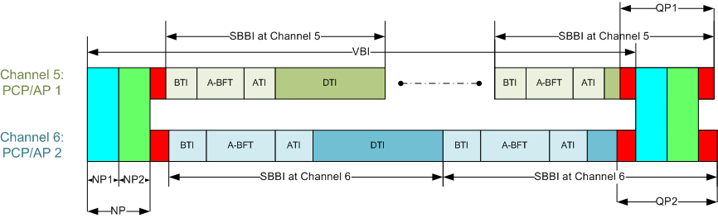
802.11aj technical features
11aj considers the following:
Link Budget Analysis for 40-50 GHz Indoor Usage
Multi-Carrier Training Field for OFDM Transmission in the 45GHz
Packet Encoding Solution for 45GHz
A Proposed frame structure is as follows
June 2022

Slide 15
802.11ak enables an 802.11 connection to be used as a through link in a general network
This amendment enables an 802.11 connection to be used as a through link in a general network, not just as a connection to an end station at the edge of a network.
Fully general mixed 802.11 and wired plug and play in the home.
Data Center top-of-rack to top-of-rack connections for overflow traffic.
Industrial and Enterprise network use.
June 2022
15

Slide 16
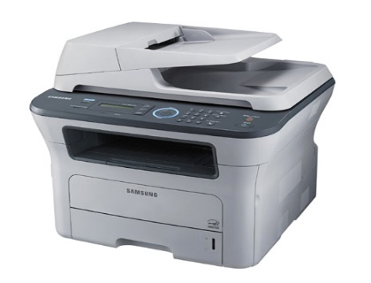



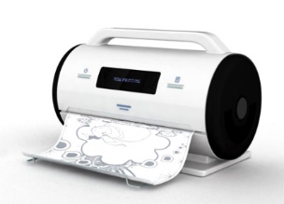
802.11aq enables the delivery of pre-association Service Discovery information
A typical use case is printer discovery in a hotel
Pre-association protocol designed to discover services on a WLAN
June 2022
16

Slide 17
802.11aq technical features
Container MAC protocol to carry upper layer service discovery protocols (e.g. UPnP, Bonjour)
Provisioning and configuration of services in the access point
  Service Transaction Proxy is a logical element connected to the access point
Universal identification of services
  Using a hash name
  Provide service attributes (e.g. 3D printer capability or point of sale service)
Currently considering request/response or broadcast concept
June 2022
17

Slide 18

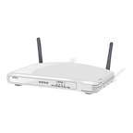
802.11ax is focused on improving performance in dense environments
Existing 802.11 WLAN systems serve dense deployments: 2019 Super bowl: 24TB* of data carried on WLAN network
802.11ax aims to further improve performance of WLAN deployments in dense scenarios
  Targeting at least 4x improvement in the per-STA throughput compared to 802.11n and 802.11ac.
  Improved efficiency through spatial (MU MIMO) and frequency (OFDMA) multiplexing.
Dense scenarios are characterized by large number of access points and large number of associated STAs deployed in geographical limited region
  e.g. a stadium or an airport.
  * https://www.extremenetworks.com/resources/slideshare/wi-fi-engagements-from-super-bowl-liii/
Access to Internet, latest airlines’ announcements, and digital media such as movies and sport events
June 2022
18
Notes:
Reference: https://www.extremenetworks.com/resources/slideshare/wi-fi-engagements-from-super-bowl-liii/
AX is the next major MAC PHY that will come to the market. Already some products R&D announced. More be shipped and certified in 2019
Primary goal of 802.11 AX is to improve the performance of wireless LANs in dense scenarios. Targeting at least 4x improvements in the throughput per client device over 802.11n and ac.
Technologies used are MU-MIMO and OFDMA

Slide 19

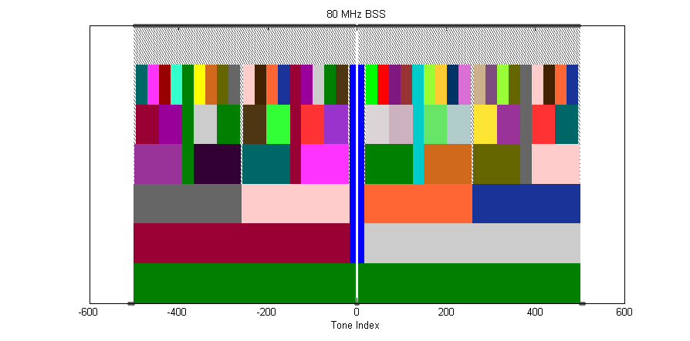
802.11ax Categories of Enhancements
Spectral Efficiency & Area Throughput
High Density
DL/UL MU-MIMO
w/ 8 clients
OFDMA
1024 QAM
25% increase
in data rate
Long OFDM
Symbol
Spatial Reuse
ac
ax
8x8 AP
2x increase
in throughput
Up to 20%
increase
in data rate
Power Saving
Outdoor / Longer range
Scheduled sleep and wake times
Extended range packet structure
20 MHz-only clients
Enhanced delay
spread protection-
long guard interval
0.8us 11ac
1.6us 11ax
3.2us 11ax
June 2022
19

Slide 20
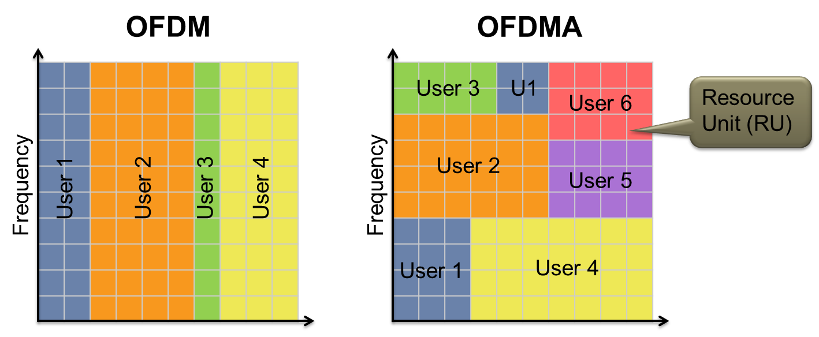
OFDMA enables further AP customization of channel use to match client and traffic demands
Increased efficiency for (high percentage of traffic) short data frames
June 2022
20
Notes:
OFDMA is a radio modulation technique that provides the ability to customize at very low level the channel use to match client and traffic demands.
You can see the pictorial difference between OFDM and OFDMA.
- In OFDMA, it is possible to provide service to multiple users during the same time and frequency, especially when there are high % of traffic consists of short data frames. This provides extreme improvement in the efficiency.
OFDMA allocates subsets of frequency to specific users. OFDMA enables greater flexibility to send data to multiple users at the same time.
This technique can reduce delay and latency for traffic.

Slide 21
BSS Coloring enables additional channel re-use
All same-channel BSS block
Same-channel BSS only block on Color Match
2
2
1
5
2
1
5
2
4
1
5
2
4
1
5
3
7
4
1
5
3
7
4
6
3
7
4
6
3
7
2
6
3
7
2
6
1
5
2
6
1
5
4
1
5
2
4
3
7
4
1
5
3
7
6
3
7
4
6
6
3
7
6
June 2022
21

Slide 22
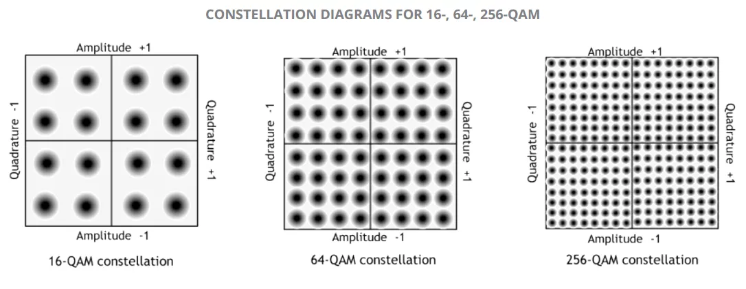
802.11ax Increases link efficiency
Increased tone density
Squeeze more tones in around DC and edge
Frequency domain
(~5% gain)
VHT
HE
FFT window
VHT
GI
DATA
GI
DATA
GI
DATA
GI
DATA
GI
DATA
…
Guard interval (GI) overhead reduced
Time domain
(~15% gain)
4 times
HE
GI
DATA
GI
DATA
…
Modulation
(~25% gain)
+ 1024-QAM
June 2022
22
Notes:
This slide shows the techniques that are used in 802.11 ax to obtain the improvements in link efficiency. They can applied in 3 domains: Frequency domain, Time domain, and Modulation.

Slide 23
UL/DL multi-user links in 802.11ax will support more efficient UL data
DL BA (STA 1)
DL BA (STA 2)
DL BA (STA n)
VHT
UL Data (STA 1)
UL Data (STA 2)
UL Data (STA n)
Trigger
Multi-STA BA
(STA 1-n)
HE
Preamble
UL Data (STA 1)
:
Data (STA n)
  In a VHT UL sequence, STAs compete for medium access and send sequentially
  In an HE UL sequence, the AP triggers simultaneous transmissions in multiple STAs
June 2022
23

Slide 24
802.11ax Data exchange sequences: Multi-user downlink
In a VHT DL MU sequence acknowledgements are serialized
In an HE DL MU sequence acknowledgements are allocated UL resources and transmitted simultaneously
Preamble
DL Data (STA 1)
BAR
BAR
:
VHT
DL Data (STA 4)
BA STA #1
BA STA #2
BA STA #4
Preamble
DL Data (STA 1)
:
HE
DL Data (STA 4)
BA STA #1
BA STA #2
: :
BA STA #n
June 2022
24

Slide 25

Uplink MU-MIMO
UL MU-MIMO was initially considered in 802.11ac, but not included due to implementation concerns
Sounding frames, data frames, etc can be grouped among multiple users to reduce overhead and increase uplink response time
8x 1SS
June 2022
25

Slide 26
Various features in 802.11ax will support improved outdoor operation
  Operates in higher delay spread channels than 802.11ac:
    802.11ac GI options: 0.4 µs and 0.8 µs
    802.11ax GI options: 0.8 µs, 1.6 µs and 3.2 µs
    GI overhead mitigated with longer OFDM symbol
  Preamble includes repeated L-SIG
  Extended range preamble includes repeated HE-SIG-A
  Dual carrier modulation improves robustness in Data field
June 2022
26

Slide 27
802.11ax meets the MAC/PHY requirements for 5G Indoor Hotspot test Environment defined by IMT-2020
Analysis and simulations confirm that performance of IEEE 802.11ax MAC/PHY meet or exceed 5G requirements for the 5G Indoor Hotspot use case
Similar studies are underway for the Dense Urban test environment
 | Metric | ITU-R Evaluation Method | Minimum Requirement | 802.11ax Performance
1 | Peak data rate | Analytical | DL/UL : 20/10 Gbps | DL/UL : 20.78 Gbps [Note 1]
2 | Peak spectral efficiency | Analytical | DL/UL : 30/15 bits/s/Hz | DL/UL : 58.01 bits/s/Hz [Note 2]
3 | User experienced data rate | Analytical for single band and single layer; Simulation for multi-layer | Not applicable for Indoor Hotspot | Not applicable
4 | 5th percentile user spectral efficiency | Simulation | DL/UL : 0.3/0.21 bits/s/Hz | DL/UL : 0.45/0.52 bits/s/Hz [Note 3]
5 | Average spectral efficiency | Simulation | DL/UL : 9/6.75 bits/s/Hz/TRxP | DL/UL : 9.82/13.7 bits/s/Hz/TRxP [Note 3]
6 | Area traffic capacity | Analytical | DL : 10 Mbit/s/m² | Required DL bandwidth = 170 MHz with 3 TRxP/site. [Note 4]
7 | Mobility | Simulation | UL : 1.5 bits/s/Hz | UL : 9.4 bits/s/Hz
8 | Bandwidth | Inspection | 100 MHz, scalable | 20/40/80/80+80/160 MHz
9 | User plane latency | Analytical | DL/UL : 4 ms | DL/UL : 80 us [Note 5]
June 2022
27

Slide 28
802.11ay is defining next generation 60 GHz: increased throughput and range
20Gbps+ rates are defined
License- Exempt bands above 45Gbps
Completion in 2020; First chipsets announced
Use Cases:
  Ultra-Short Range
  8K UHD - Smart Home
  AR/VR and wearables
  Data Center Inter Rack connectivity
  Video / Mass-Data distribution
  Mobile Offloading and MBO
  Mobile Fronthauling
  Wireless Backhauling (w. multi-hop)
  Office Docking
  Fixed Wireless
Key additions :
  SU/ MU MIMO, up to 8 spatial streams
  Channel bonding
  Channel aggregation
  Non-uniform constellation modulation
  Advanced power saving features
June 2022
28

Slide 29
60 GHz Fixed Wireless Use Case: Affordable 5G Performance
“the 14 GHz of contiguous spectrum in the band offers more bandwidth than any other licensed or unlicensed mmWave band. Further, the 60 GHz band has chipsets and technology currently available on the commercial market.”
“In the U.S., unlicensed mmWave frequencies available for 5G primarily cover the band from 57 – 71 GHz, called the V-Band, or 60 GHz band. This band offers 14 GHz of contiguous spectrum, which is more than all other licensed and unlicensed bands combined7. This makes the 60 GHz band an excellent alternative to licensed mmWave frequencies for smaller providers, as it can be used to deliver 5G performance for the minimal cost of available 60 GHz infrastructure products.
https://go.siklu.com/hubfs/Content/White%20Papers/Maravedis%20Industry%20Overview:%205G%20Fixed%20Wireless%20Gigabit%20Services%20Today.pdf
https://www.fiercewireless.com/wireless/60-ghz-band-particularly-appealing-for-fixed-wireless-report
June 2022
29

Slide 30

60 GHz Mesh Backhaul Wireless Use Case: Deploying Today
“Leading Wi-Fi and wireless network solution vendor Cambium Networks announced today that they will be incorporating Facebook’s Terragraph technology into a new series of Cambium Networks 60 GHz radio products called cnWave™. The news comes as Terragraph appears to be ramping up go-to-market activities with trials underway in Hungary and most recently in Malaysia.”
“Terragraph is essentially a 60 GHz-based meshed (or multi-hop, multi-point) backhaul radio system for deployment at street level in cities.”
https://wifinowevents.com/news-and-blog/cambium-networks-to-incorporate-facebook-terragraph-tech-into-new-60-ghz-products/
June 2022
30

Slide 31
60 GHz Worldwide Spectrum
Worldwide, unlicensed, spectrum availability
4 bands available in EU and Japan
Recently expanded spectrum in U.S. from 57 – 71GHz, additional countries also considering expansion
U.S. (57.00 GHz – 71.00 GHz)
EU (57.00 GHz – 66.00 GHz)
South Korea (57.00 GHz – 64.00 GHz)
Japan (57.00 GHz – 66.00 GHz)
Australia (57.00 GHz – 71.00 GHz)
China (59.00 GHz – 64.00 GHz)
Channel 1
Channel 2
Channel 3
Channel 4
Channel 5
Channel 6
57.00 GHz
57.24 GHz
59.40 GHz
68.04 GHz
70.2 GHz
61.56 GHz
63.72 GHz
65.88 GHz
71.00 GHz
June 2022
31
Notes:
Australia consultation to extend to upper bands

Slide 32
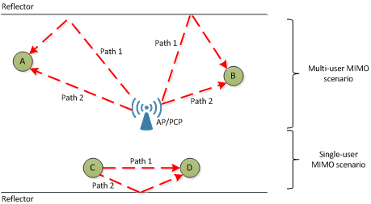
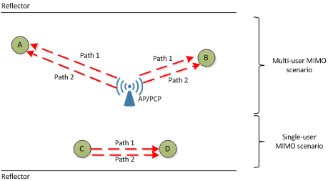
802.11ay builds on 802.11ad with MIMO and channel bonding features
Example without polarization
Channel bonding and aggregation requires new:
  Channelization
  Packet format
  Channel access mechanisms
Single User and downlink MU MIMO
  Distribute capacity across users
  Unique requirements given directionality
  Exploit antenna polarization
  Changes to the beamforming protocol
Example with polarization
June 2022
32

Slide 33
802.11ay defined channelization
June 2022
33

Slide 34
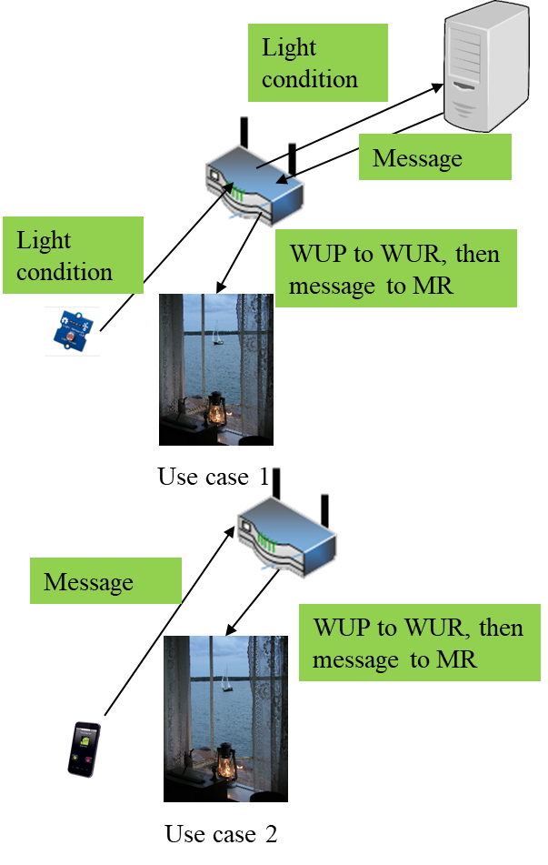
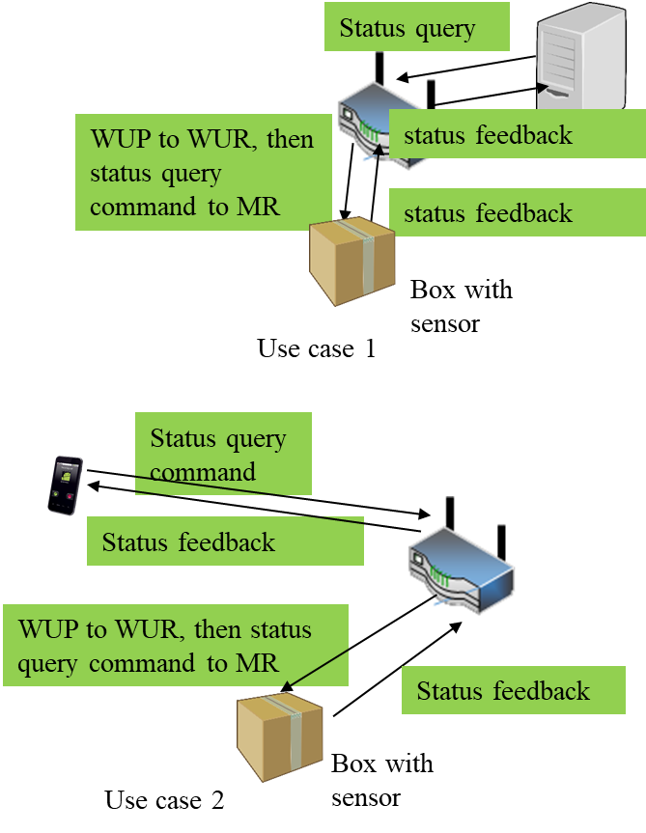
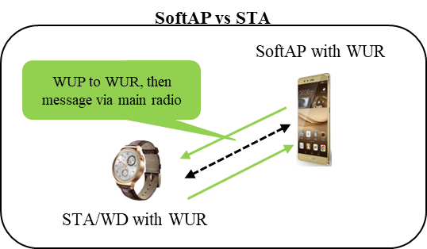
802.11ba Wake-up Radio Main Use Cases
1. Smart Home
2. Warehouse
3. Wearables
WUP: wake-up packet
WUR: wake-up receiver
MR: main radio
34

Slide 35


802.11ba improves energy efficiency of stations and maintains low latency
Internet
Internet
AP buffers data until the 802.11 station wakes up
→ Long latency
data
Buffer
data
Do you have data for me?
Buffer
Do you have data for me?
No
Do you have data for me?
802.11 radio needs to wake up periodically to receive data within a latency requirement → high power consumption of 802.11 station
No
No
Awake
Awake
802.11 station
802.11 station
Sleep
Sleep
Short sleep interval
Long sleep interval
June 2022
35
Notes:
802.11ba focuses on improving the power efficiency of 802.11 stations, enabling longer batter life.

Slide 36
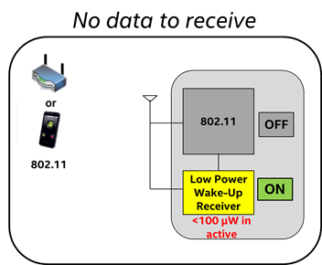
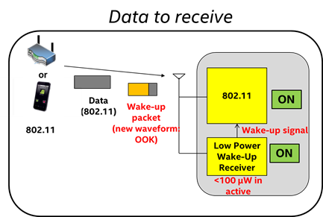
802.11ba Low-power Wake-up Receiver (LP-WUR) as Companion Radio for 802.11
Comm. Subsystem = Main radio (802.11) + LP-WUR
  Main radio (802.11): for user data transmission and reception
    Main radio is off unless there is something to transmit
    LP-WUR wakes up the main radio when there is a packet to receive
    User data is transmitted and received by the main radio
  LP-WUR: not for user data; serves as a simple “wake-up” receiver for the main radio
    LP-WUR is a simple receiver (doesn’t have a transmitter)
    Active while the main radio is off
    Target power consumption < 1 mW in the active state
      Simple modulation scheme such as On-Off-Keying (OOK)
      Narrow bandwidth (e.g. < 5 MHz)
    Target transmission range: LP-WUR = Today’s 802.11
June 2022
36
Notes:
802.11ba introduces the use a a “wake-up receiver” which can remain active at extremely low power, detecting when traffic is present for the main radio.

Slide 37


802.11ba Low Power Wake-up Radio Operation
Transmission range
or
Data
Packet
802.11 = LP-WUR
Transmitter
Receiver
802.11
802.11
802.11
802.11
ON
OFF
OFF
+
ON
802.11
Wake-up
Packet
Wake-up signal
LP-WUR
ON
Wake-up
Packet
June 2022
37

Slide 38

The ARChitecture SC (ARC) meets on an ongoing basis
It does not develop a standard or amendment
Discussion of 802.11 architecture issues for other ongoing amendments
Topics for discussion include:
  Architectural clauses and models in the standard, as questions, or needs for update or clarification arise.
  Relationships with outside groups on 802.11 architectural topics, or topics that don’t fit elsewhere, such as IETF, 802 O&A, and 802.1.
June 2022
38

Slide 39
ARC technical considerations
Models for STA architecture and related concepts, and overall system architecture, included in the Standard in clauses 4 and 5, generally.
Evolution of the models, either to consider amendments to the Standard, or as clarification is needed
Define how 802.11 technologies fit into 802, 802.1 and IETF use cases.
June 2022
39

Slide 40
Thank You
Questions
June 2022

